Slide 1
Course Title Design and Analysis of Algorithms
Dr. Athira K SCOPE

Slide 2
Algorithm
An algorithm is a finite sequence of logically related instructions to solve a computational problem
Any algorithm must have
Input provided by user
produce an output
Unambiguous instructions that should terminate after a finite number of steps
– How to design an algorithm for a given problem?
– Is every problem algorithmically solvable? If so, how many algorithms can a problem have and how to find the efficient one

Slide 3
Algorithm
Algorithm is a tool for solving a well-specified computational problem.
Any particular input is called an instance
An algorithm is said to be correct if, for every input instance, it halts with the correct output.
An incorrect algorithm might not halt at all on some input instances, or it might halt with an incorrect answer

Slide 4
Why to study algorithms?
Computers are not infinitely fast, and memory is not free
If computers were infinitely fast, any correct method for solving a problem would do.
Computers may be fast, but they are not infinitely fast.
And memory may be inexpensive, but it is not free
Computing time and memory are therefore bounded resources
These resources are to be used wisely
Algorithms that are efficient in terms of time or space will help with that.

Slide 5
Why study of analysis of Algorithm?
Analysis of algorithm is the theoretical study of performance and resource usage of computer program
Performance draw line between feasible and unfeasible
Is there any other factors important than the performance of an algorithm, involved in the design of a software?

Slide 6
Examples:
Finding a maximum element in an array
Algo Max-array(A, n)
{ Max = A[1];
for i = 2 to n
do if ( A[i] > Max )
then Max = A[i];
return Max; }
There are at least five different algorithms to find a maximum element, and which is the efficient algorithm?
Estimation of time and space complexity provide an insight into reasonable directions of search for finding the efficient algorithm

Slide 7
Stages of Algorithm Development
Describing the problem
Identifying a suitable technique
Design of an algorithm
Proof of Correctness of the algorithm

Slide 8
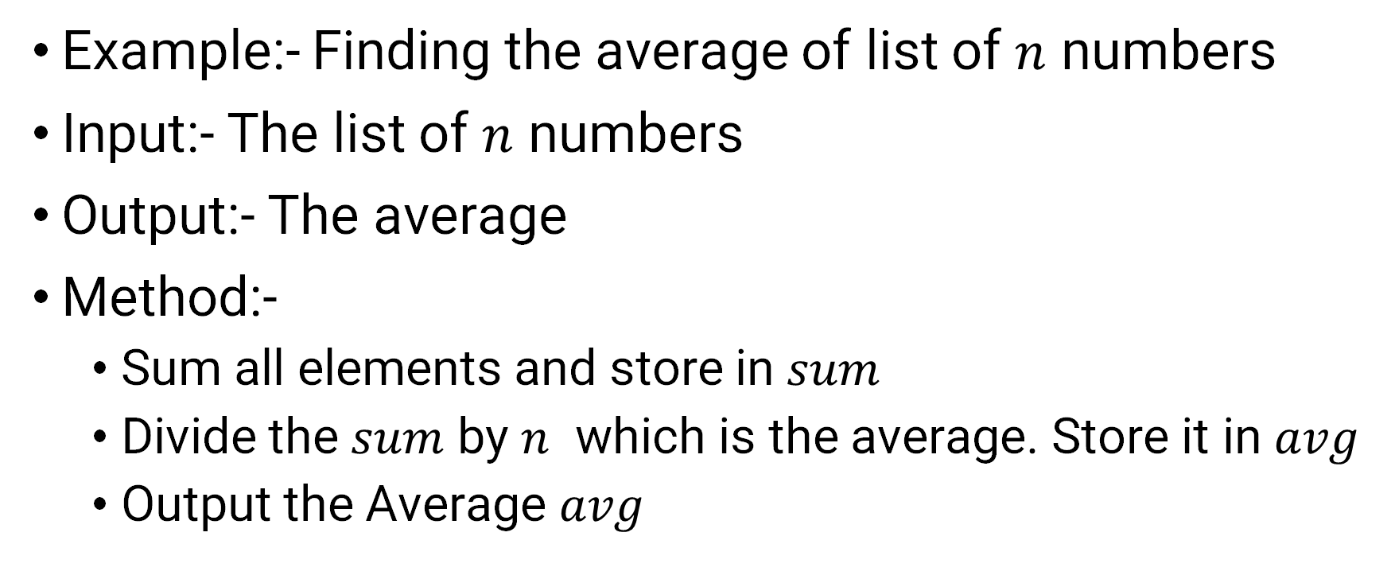
Describe the problem & Find a method
Example:- Finding the average of list of $n$ numbers
Input:- The list of $n$ numbers
Output:- The average
Method:-
Sum all elements and store in $sum$
Divide the $sum$ by $n$ which is the average. Store it in $avg$
Output the Average $avg$

Slide 9
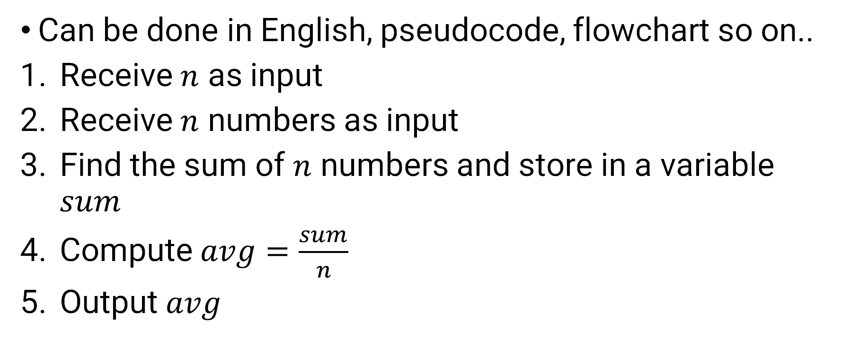
Design an algorithm
Can be done in English, pseudocode, flowchart so on..
Receive $n$ as input
Receive $n$ numbers as input
Find the sum of $n$ numbers and store in a variable $sum$
Compute $avg=\frac{sum}{n}$
Output $avg$

Slide 10
Correctness of Algorithm
Correct:- if, for every input instance, it halts with the correct output
An incorrect algorithm
may not halt at all for some input instances, or
may halt with a wrong output
Correct if the algorithm yields the desired output for the specific input in a finite amount of time.
Proof of correctness depends on the algorithm

Slide 11
Correctness of Algorithm [cont..]
For some algorithms, the proof of correctness is easy and for some algorithms, it is complex
It depends on the type of instructions in the algorithm
In order to show that an algorithm is incorrect, one instance of input is sufficient for which the algorithm fails to give the desired output

Slide 12
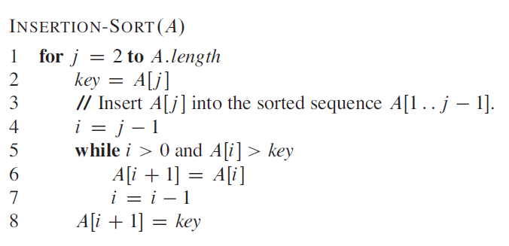
Proof of correctness
Explanation by example
Consider the insertion sort algorithm

Slide 13
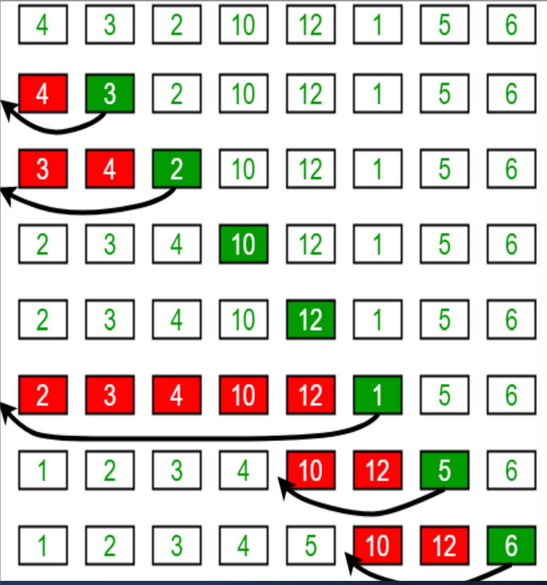

Slide 14
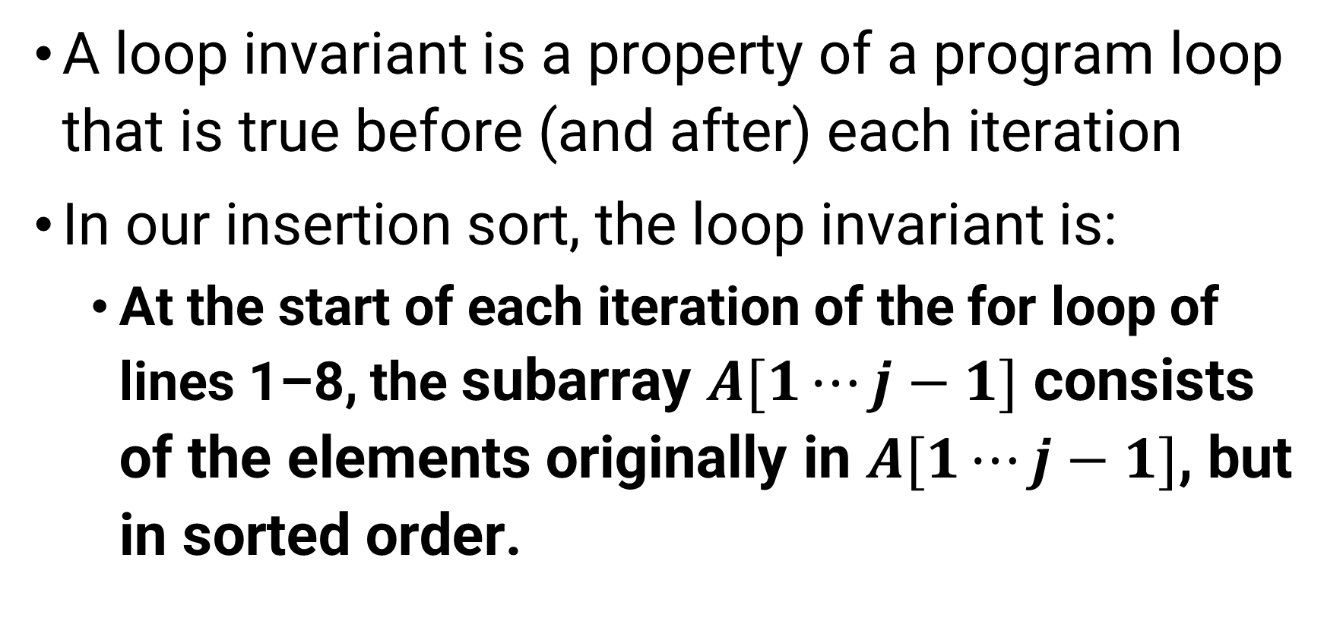
Loop invariant method
A loop invariant is a property of a program loop that is true before (and after) each iteration
In our insertion sort, the loop invariant is:
At the start of each iteration of the for loop of lines 1–8, the subarray $A[1⋯j−1]$ consists of the elements originally in $A[1⋯j−1]$, but in sorted order.

Slide 15
Loop Invariant method [cont..]
In loop invariant method of proving correctness, one must show three things about a loop invariant:
Initialization: It is true prior to the first iteration of the loop.
Maintenance: If it is true before an iteration of the loop, it remains true before the next iteration.
Termination: When the loop terminates, the invariant gives us a useful property that helps show that the algorithm is correct

Slide 16
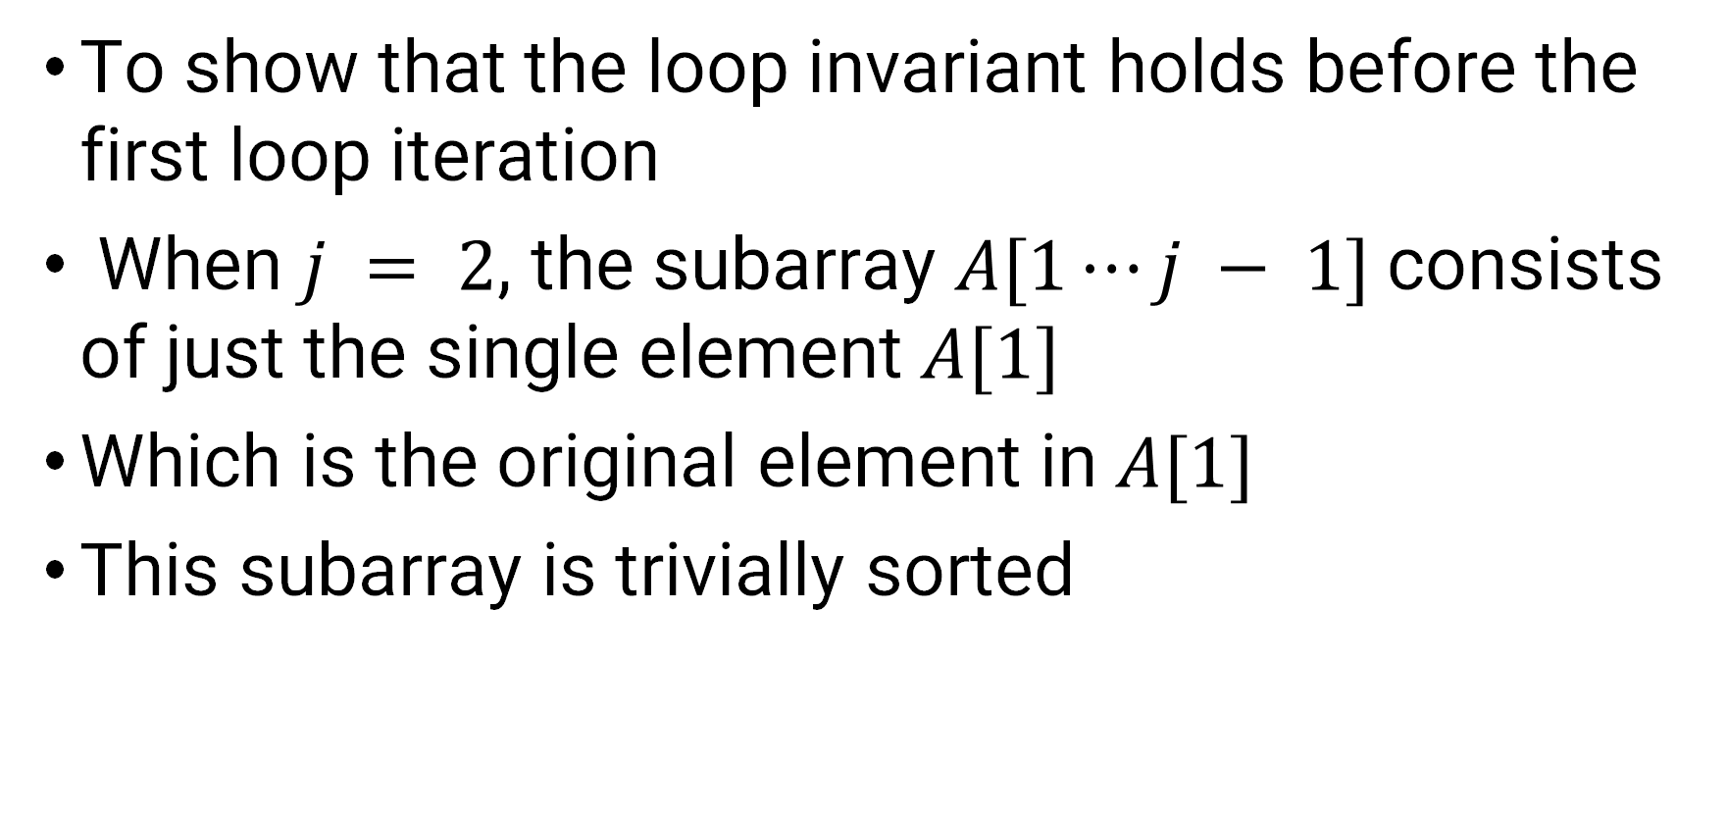
Initialization
To show that the loop invariant holds before the first loop iteration
When $j = 2$, the subarray $A[1⋯j − 1]$consists of just the single element $A[1]$
Which is the original element in $A[1]$
This subarray is trivially sorted

Slide 17
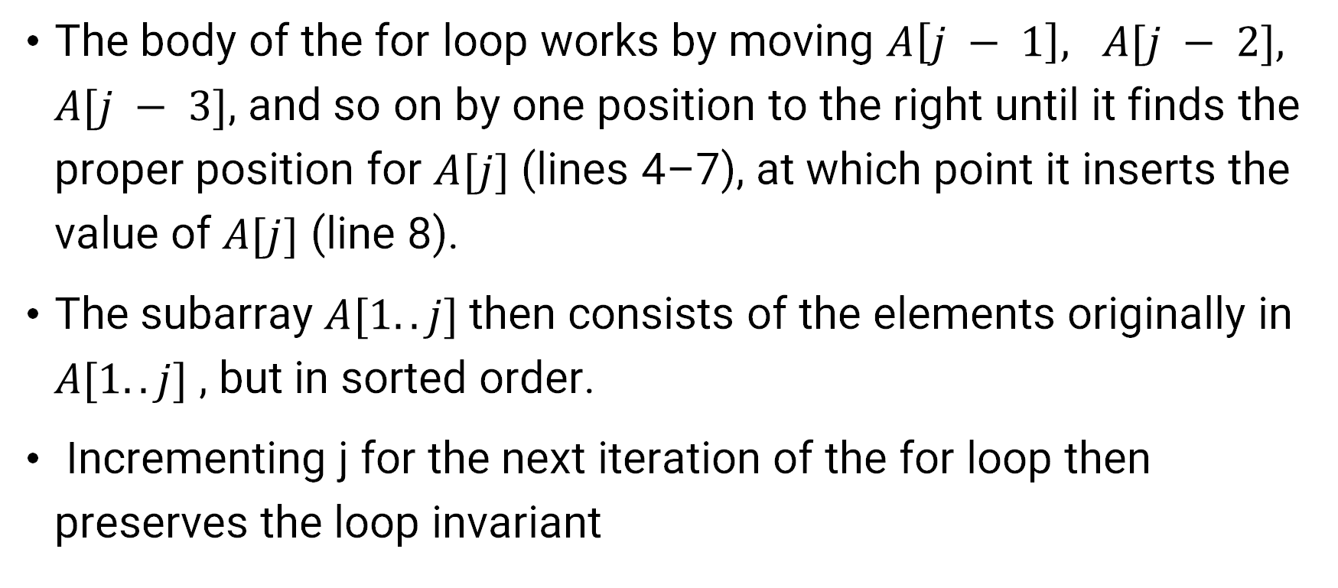
Maintenance
The body of the for loop works by moving $A\left[j − 1\right], A[j − 2], A[j − 3]$, and so on by one position to the right until it finds the proper position for $A[j]$ (lines 4–7), at which point it inserts the value of $A[j]$ (line 8).
The subarray $A[1.. j]$then consists of the elements originally in $A[1..j]$, but in sorted order.
Incrementing j for the next iteration of the for loop then preserves the loop invariant

Slide 18
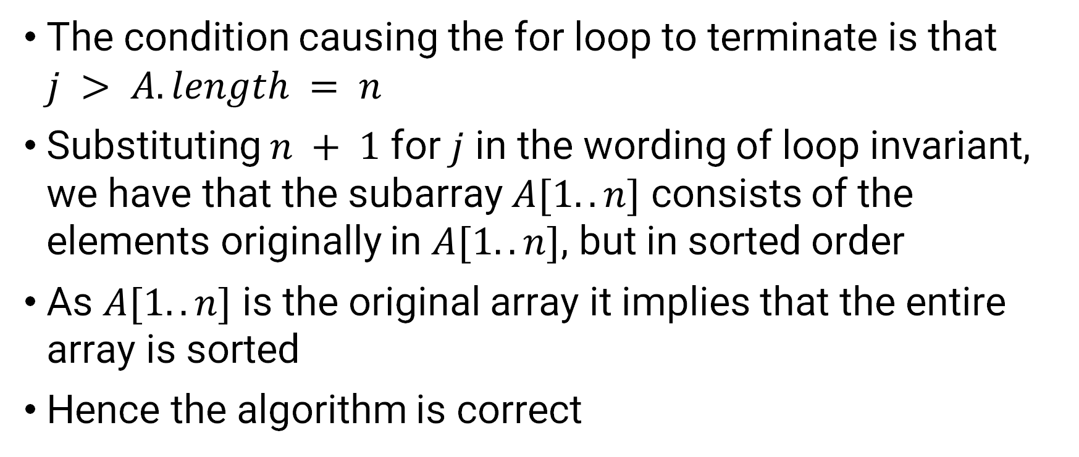
Termination
The condition causing the for loop to terminate is that $j > A.length = n$
Substituting $n + 1$ for $j$ in the wording of loop invariant, we have that the subarray $A[1..n]$ consists of the elements originally in $A[1..n]$, but in sorted order
As $A[1..n]$ is the original array it implies that the entire array is sorted
Hence the algorithm is correct

